Slide 1

The leading Swiss private school in the heart of Zurich, for committed students from Switzerland and abroad.
21. Apr. 2021, Academic Gateway

Slide 2

School development
The private school with the highest number of candidates for the Swiss Matura
2015
School Foundation
Aug. 2016
Start of a pilot class in the premises of the SAWI School
Aug. 2017
New Courses:
Matura Part-Time and Passerelle
Aug. 2020
New Course: Swiss Online Matura
Timeline
since 2014 Development of the curriculum and e-learning content with a modern didactic approach
2016/2017
Matura Full-Time (Pilot Class)
Aug. 2021
New Course: Vocational Baccalaureate Full-time & Part-time
Opening the most modern school in Switzerland
2015
Start digital classroom development
March 2020
Corona lockdown: Academic Gateway is the only educational institute in Switzerland that has ensured teaching completely online
Notes:
Gewährleistet statt garantiert

Slide 3
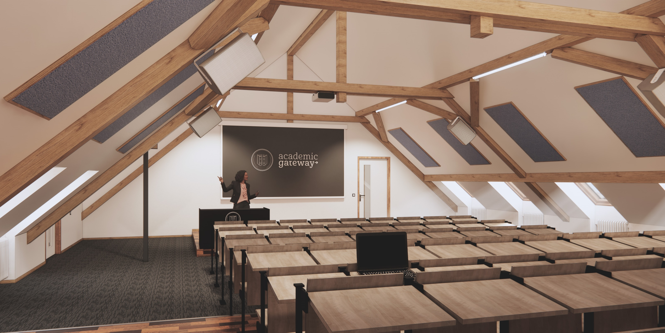
The most modern school building in Switzerland
From lecture halls to laboratories: Academic Gateway's campus offers a variety of rooms for all types of teaching and training, depending on your needs. The entire facility is technically state-of-the-art.
Whether internet, USB connections and sockets at the seats, microphones, cameras, laptops or visualisers; depending on the type of room, everything is available redundantly. This guarantees fail-safety.

Slide 4

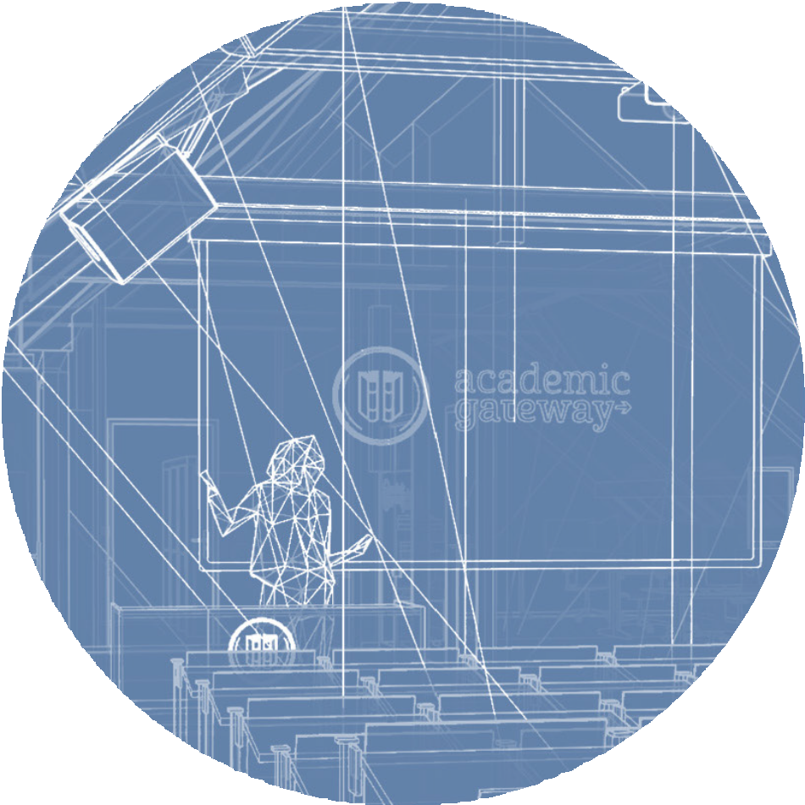


Learning today as in the future, with hybrid and online teaching.
Certified
Matura (matriculation) in one year: Academic Gateway is the only public school in Switzerland with a one-year Matura course.
Hybrid and
online teaching
Innovative
e-learning
Hybrid and online teaching, university teaching style: lnnovative e-learning platform combined with individual and goal-oriented learning and teaching methods. Academic Gateway is the only educational institute in Switzerland that offers online distance learning in a way that is in fact similar to traditional face-to-face teaching.
From August: new school building with state-of-the-art technology, wheelchair access, refectory and terrace.
Prime location: 500 metres from Zurich main station. Modern classrooms offer a high level of comfort and technology for both, students and teachers.
Goal-oriented learning methodology
Highly qualified
teaching staff
Success rate: In addition, Academic Gateway students achieve a better university degree than students from other schools.
Sustainable successrate
University
educational approach

Slide 5
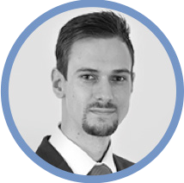
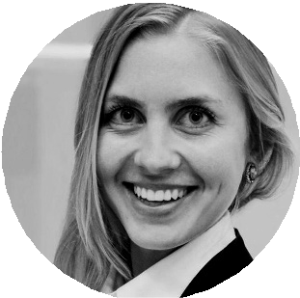
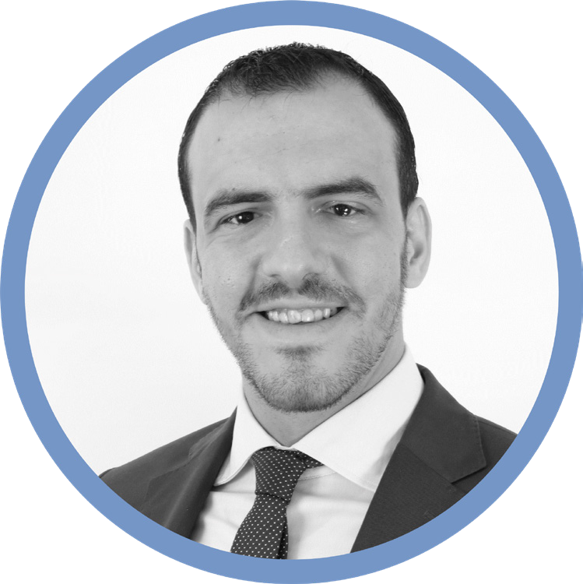
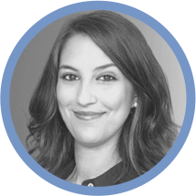
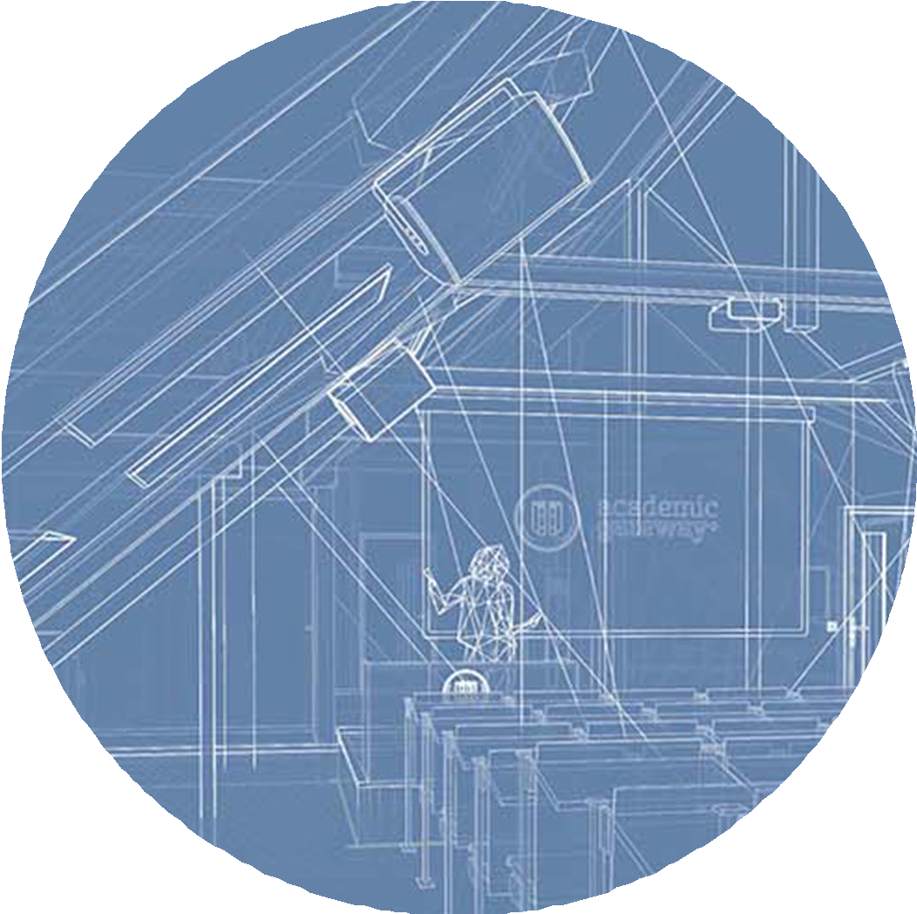
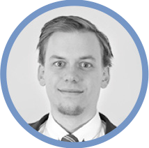
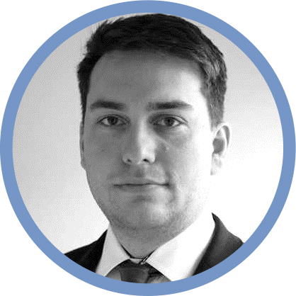
Team
Fabrizio Fuchs
Managing Director
Qualified school management
Our team strives towards results-oriented management and pedagogic school development as optimal management of staff.
Fabiennne Fiechter Head of Sales
Alexandre Touihri
Chairman of the Board
of Directors
Desiree Cinicola
Head of Administration
Thomas Müller
Principal
Dimitar Jauch
Board of Directors

Slide 6
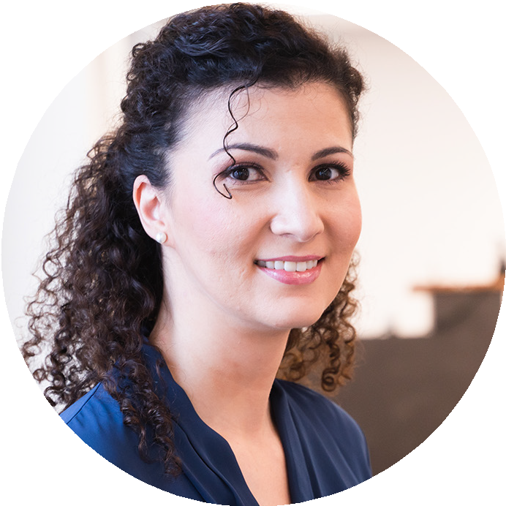
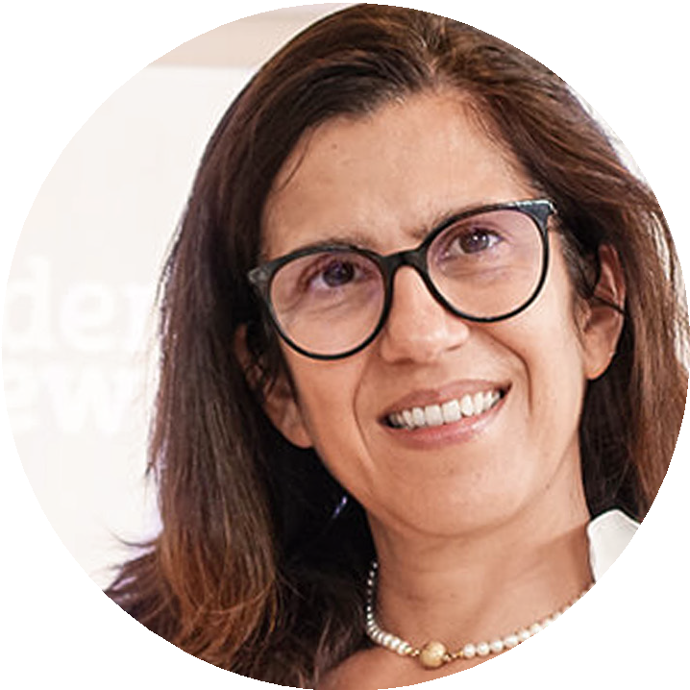
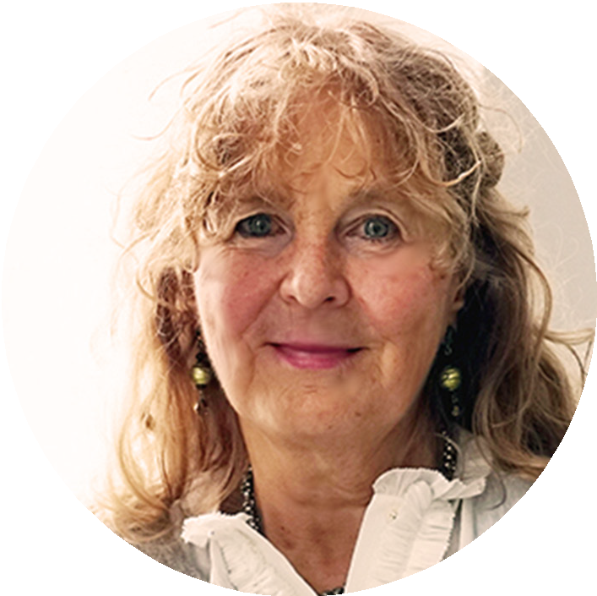
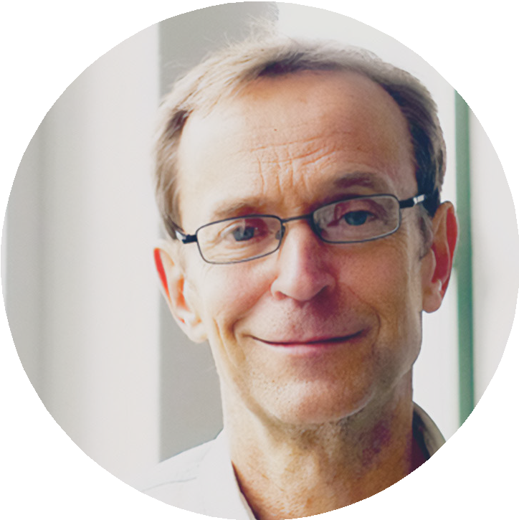
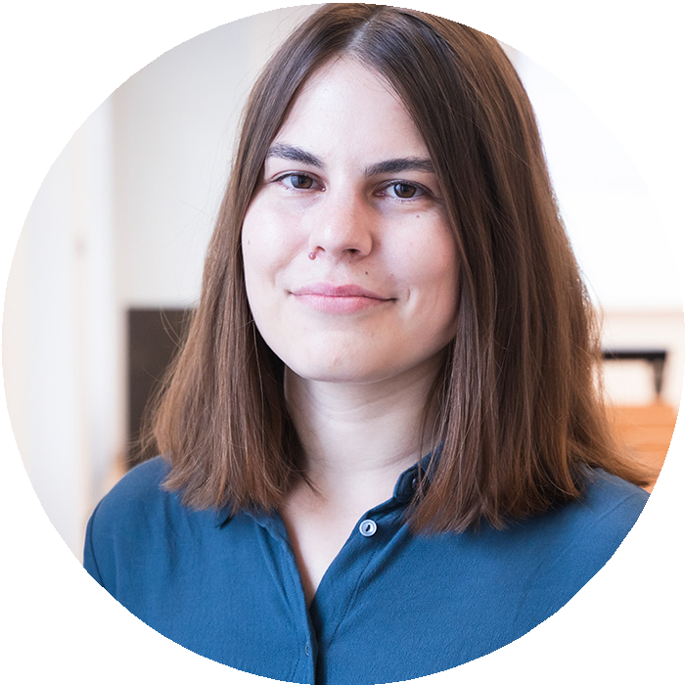
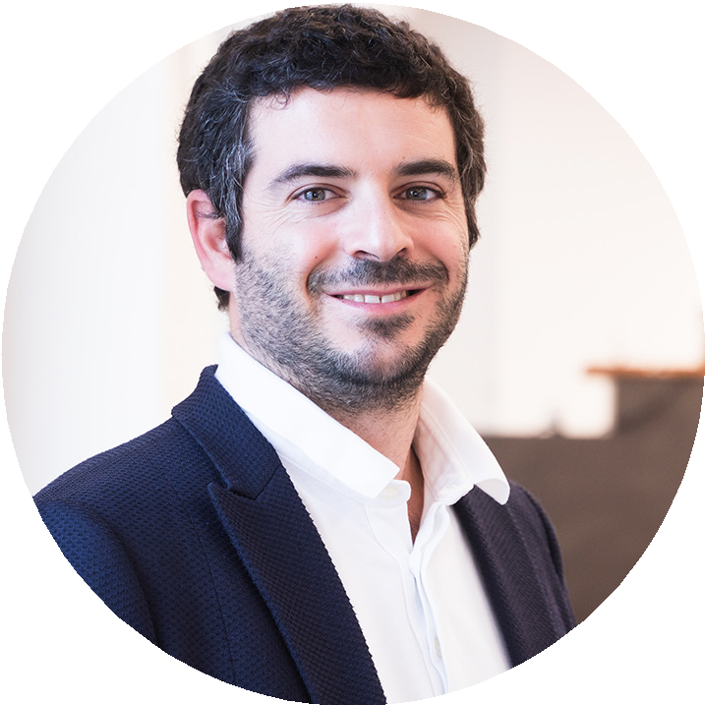
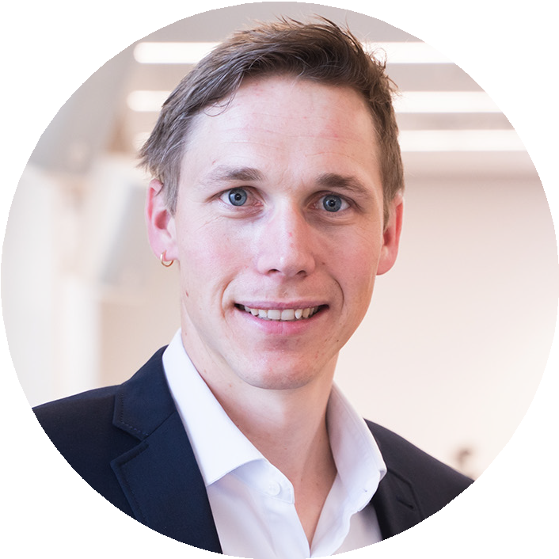
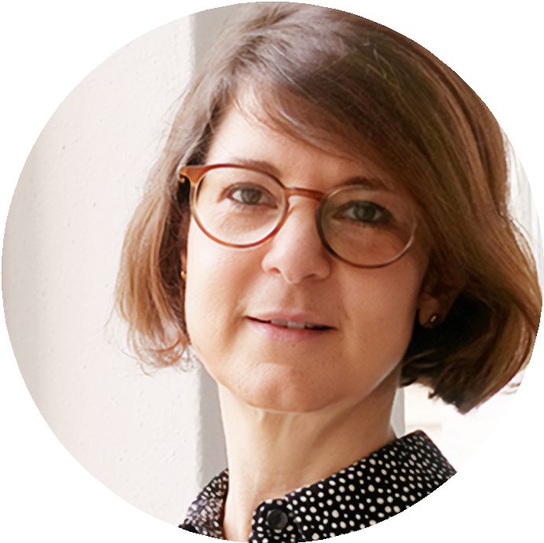
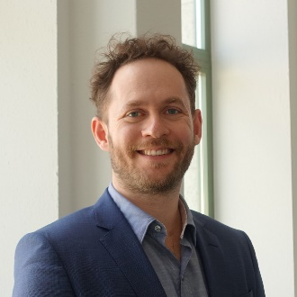
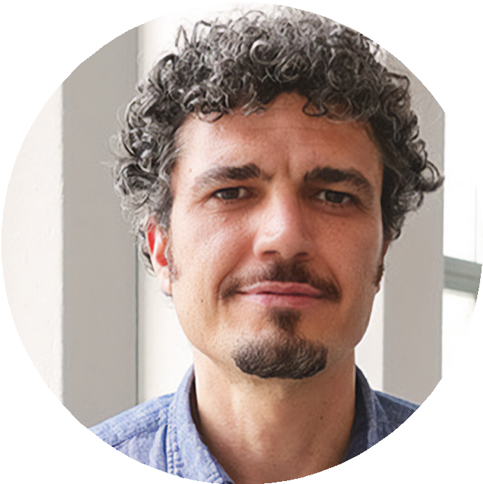
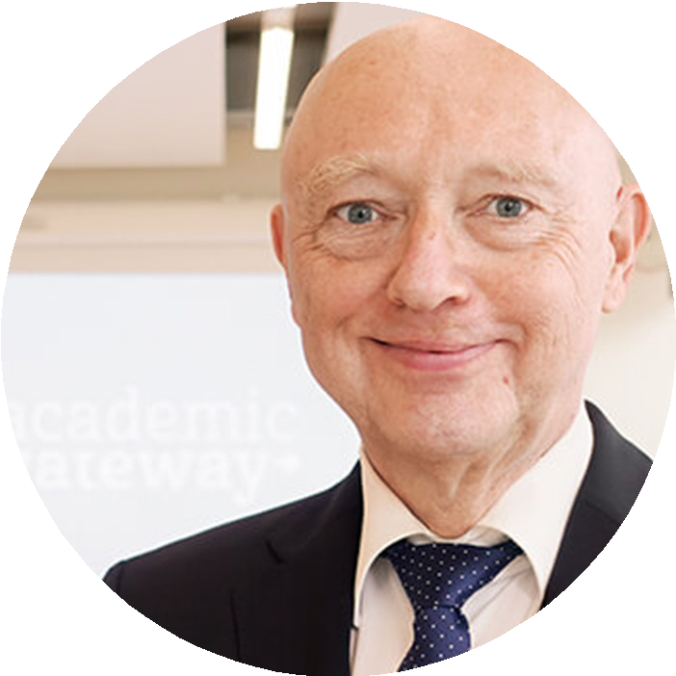
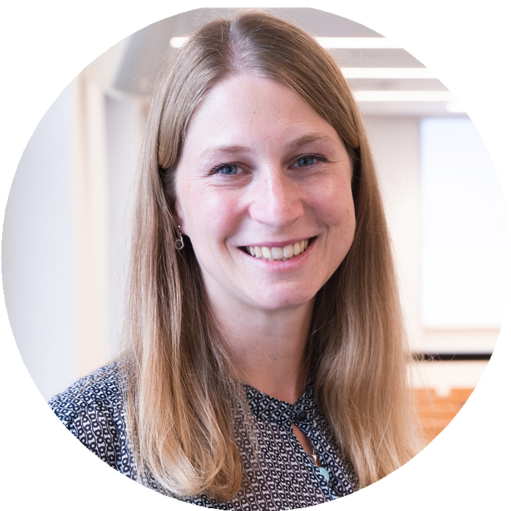
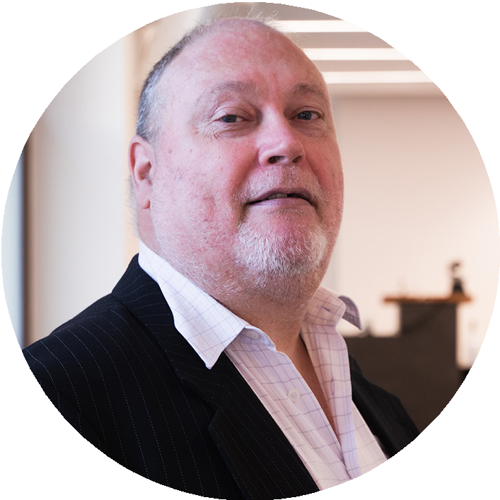
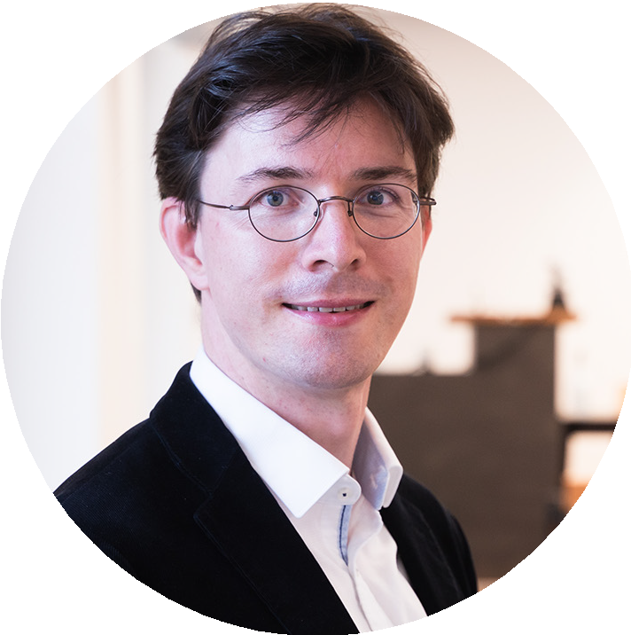
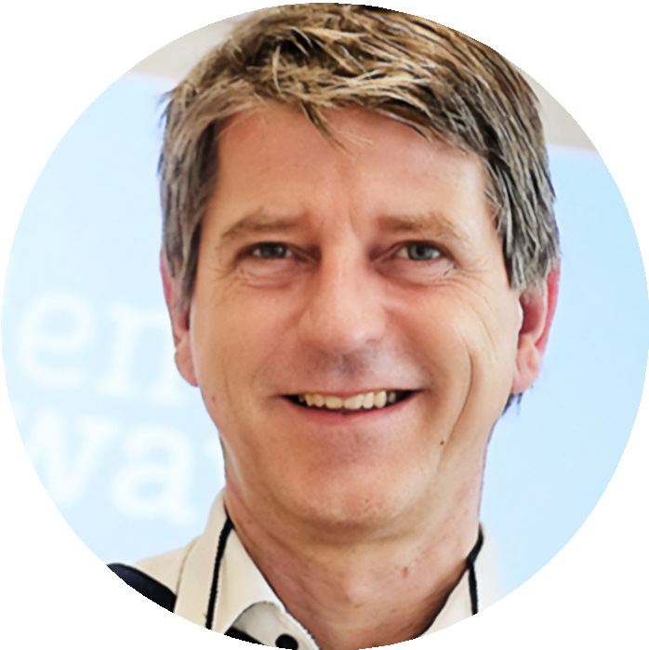
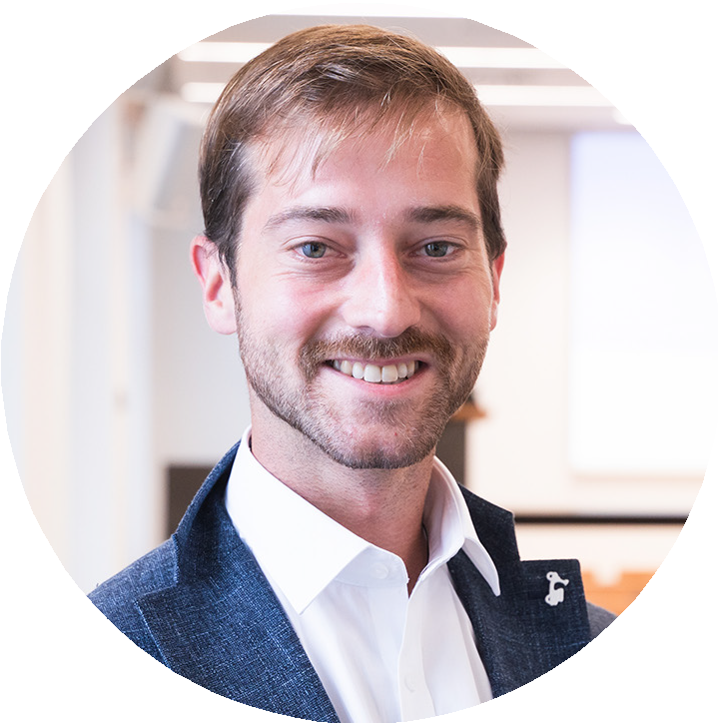
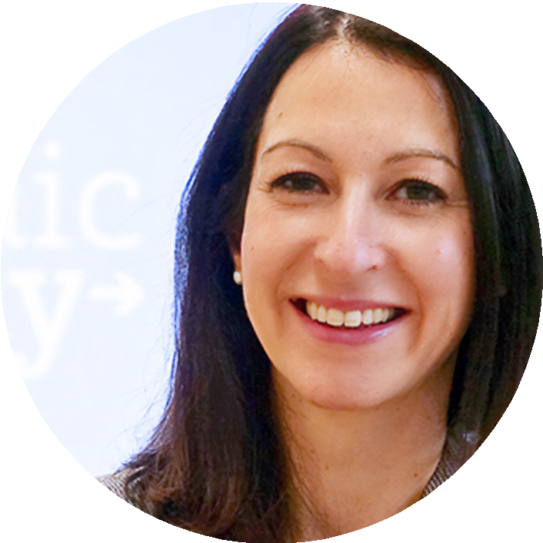
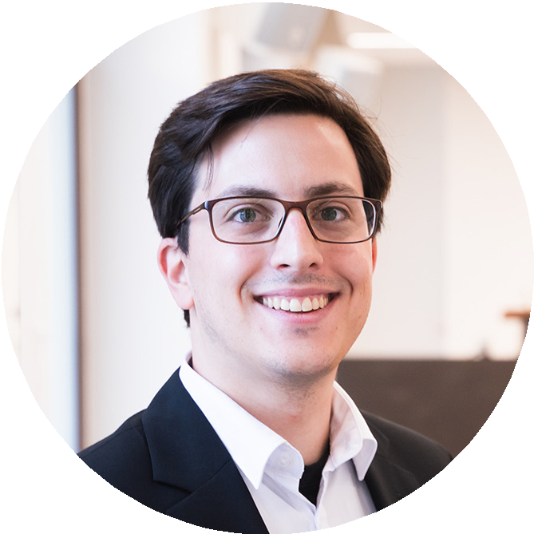
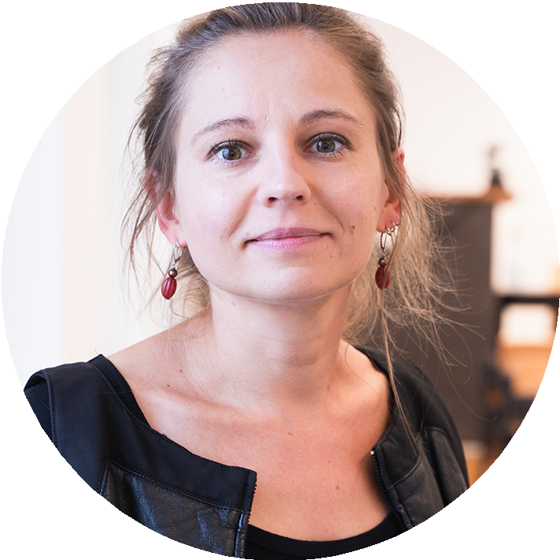
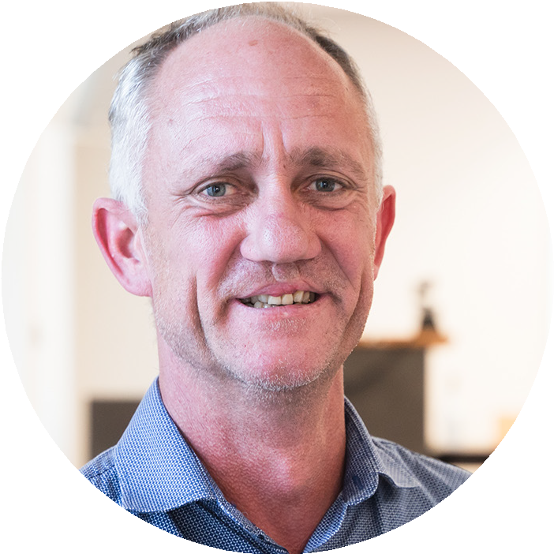
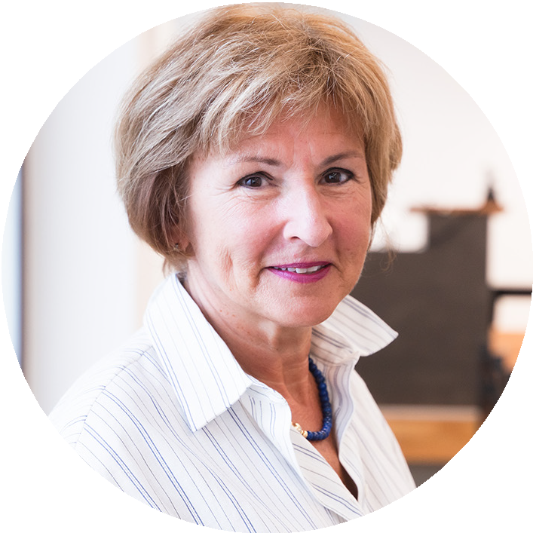
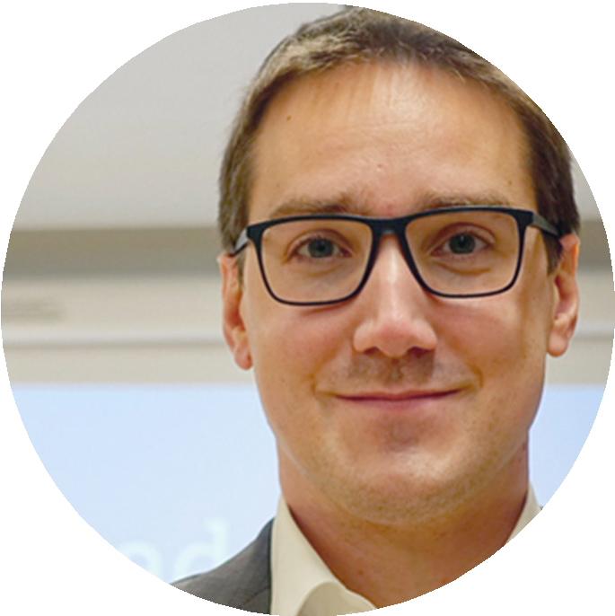
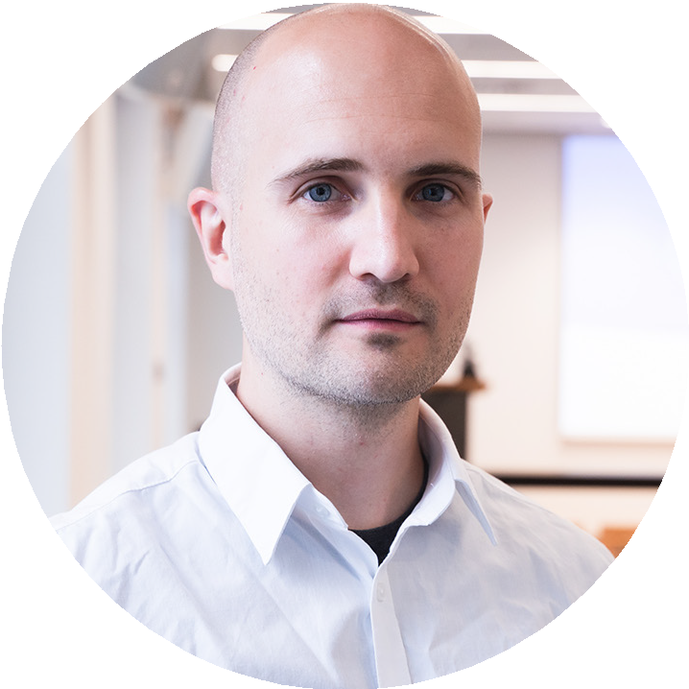
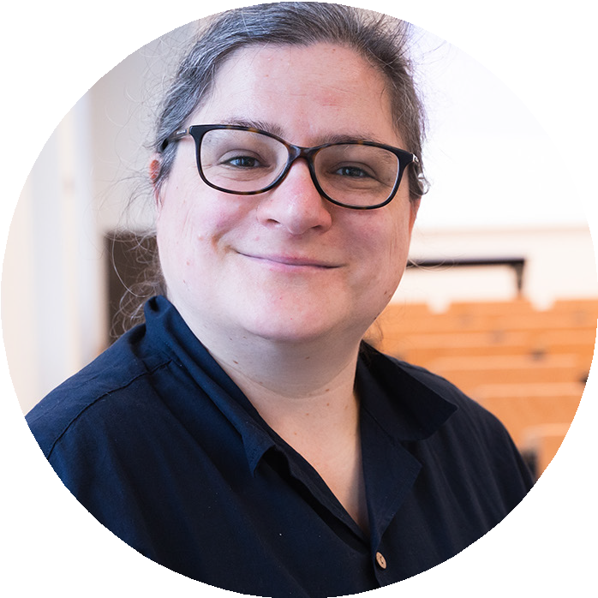
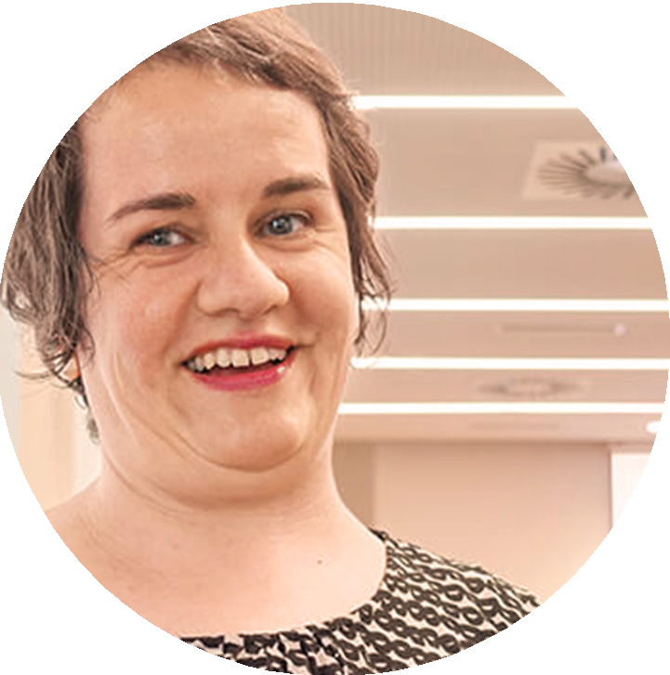
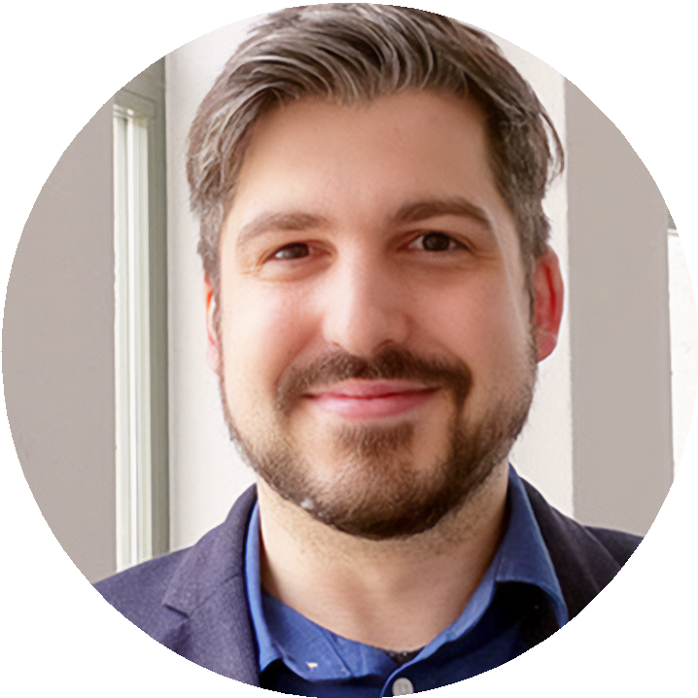
Highly Qualified Teaching Staff
Letizia Chiappetta Italian
Carmela Fronterré Italian
Gabriela Schädler French
Guy Castagnoli
Mathematics
Tabea Bühler
Geography
Simon Celentano
Geography
Clemens Fässler
History
Anna-Katharina Straumann
English
Martin Danneck
Deutsch
Juan Miguel López Merino
Spanish
Helmut Bischof
Economics, Law
Sonja Völler French
Peter Fischer
Physics
Ben Hambrecht
Physics
Arne Ramsperger
Biology, Chemistry
Michael Portmann
History
Maya Sela English
Stefan Feurer
Biology,
Chemistry
Kathrin Herbold
Visual Arts
Martin Schäfer
Biology,
Chemistry
Anna Canonica-Sawina Italian, History/
History of Art
Richard
Conrardy
Mathematics
Dominik Müller
Mathematics
Dunja
Niedermüller
Physics
Judith Bider
German
PhilippChristen
English

Slide 7












Contact to top Universities
The Swiss Matura is internationally renowned as an excellent preparation for academic studies and is considered the gold standard for entring many international and European universities
*This is not an exhaustive list and only includes some examples of the highest ranked universities in Europe

Slide 8

Key Data Swiss Online Matura
Swiss Online Matura
Lessons
Semester start: 23 August 2021
End: 23 July 2022
Teaching hours: Mon - Fri, 08:30 a.m. - 04:00 p.m
Class participation: Lectures via livestream and practice sessions via teams
First examination session: 21 - 23.02.2022 (in writing)*
Second examination session: 16.08. - 20.08.2022 (in writing)* / 27.08. - 04.09.2022 (oral)*
University start: possible from September 2022
*Registration for the federal partial examinations takes place directly via SERI.
Exam dates

Slide 9
Swiss Online Matura
Notes:
Preparation Year to Matura Courses

Slide 10

Swiss Online Matura
Requirements
The student must be at least 18 years old at the time of the second part of the examination (August 2022).
Languages
German native speaker or European language, level C2
English European language level B2
French or Italian European language level B1
Russian minimum European language level B2 (main subject)
Mathematics
Mathematics secondary level I

Slide 11
University Educational Approach
The division into lectures and practice sessions provides a solid basis for working through a demanding amount of material in a timely manner, and also prepares our students for the style of teaching at a university or a university (of applied sciences).
Notes:
Or a university (of applied sciences)

Slide 12
Subject Overview and Passing Standards
Swiss Online Matura
The matura examination is considered passed if:
1) at least 105 points achieved or a maximum of 4 unsatisfactory grades.
2) a maximum of 7 minus points (correct calculation, see table).
3) average of all examinations incl. assessments must result in at least a 4.0.
First semester | Final grade weighting | First semester | Final grade weighting
Biology | 1 | German | 3
Chemistry | 1 | Italian/French | 2
Physics | 1 | English | 3
Geography | 1 | Mathematics | 2
History | 1 | Special subject | 3
Visual Arts/ Music | 1 | Complementary subject | 1
 |  | Matura thesis | 1

Slide 13
Repetition Standards and Repetition Guarantee
Swiss Online Matura
Those who do not pass the Swiss Federal Matura and have taken both partial examinations, may, according to the Swiss Matura Commission, repeat after only half a year and only have to repeat the unsatisfactory grades.
Academic Gateway offers a free repetition for students who, within the framework of our main courses, have achieved an attendance rate of at least 95% and a pass rate of 100%.

Slide 14
Contact
Academic Gateway
Bleicherweg 5, 8001 Zurich
headoffice@academic-gateway.com
T: +41 44 310 10 67
www.academic-gateway.com

Slide 15

Q&A Session

Slide 16
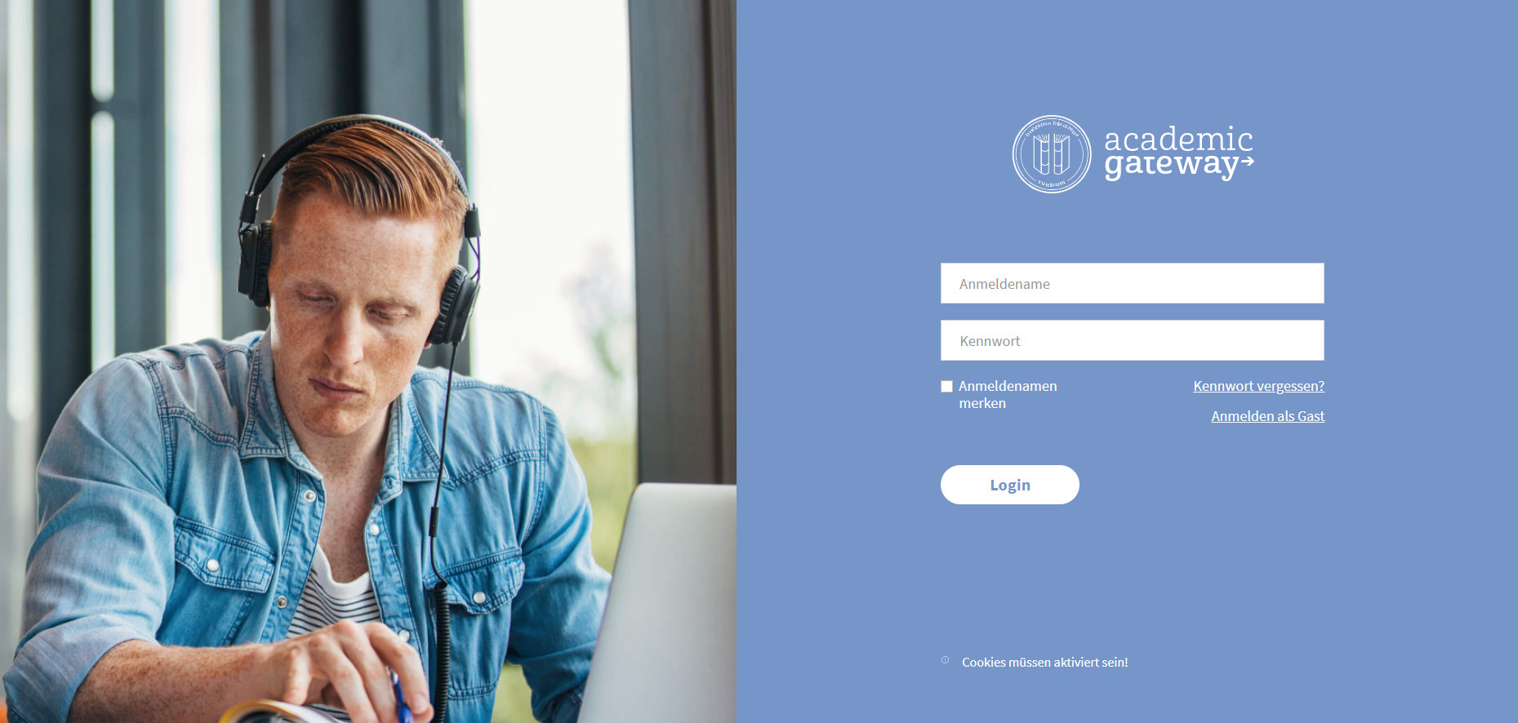
The Digital School
E-Learning Insight
The private school is specialised in the development of forward-oriented didactic teaching methods. The result is a fully integrated, scalable and flexible comprehensive e-learning solution, comprising three components:
- An integrated solution for live stream lessons
- The possibility of recording lessons as well as podcasts and teaching videos
- A user-oriented e-learning system, which includes content such as teaching materials, timetables, lesson slides, sample solutions, collections of exercises, past exams, etc.
Notes:
Nach hinten packen

Slide 17
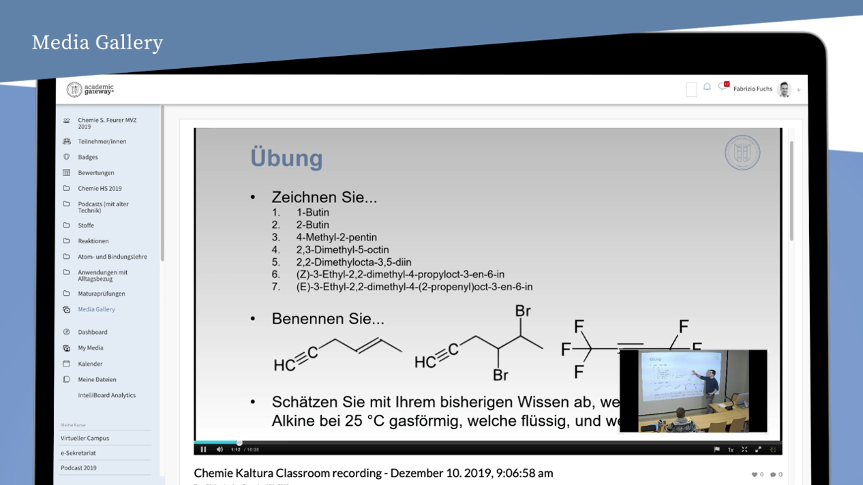
The Digital School
E-Learning Insight
Notes:
Nach hinten packen

Slide 18
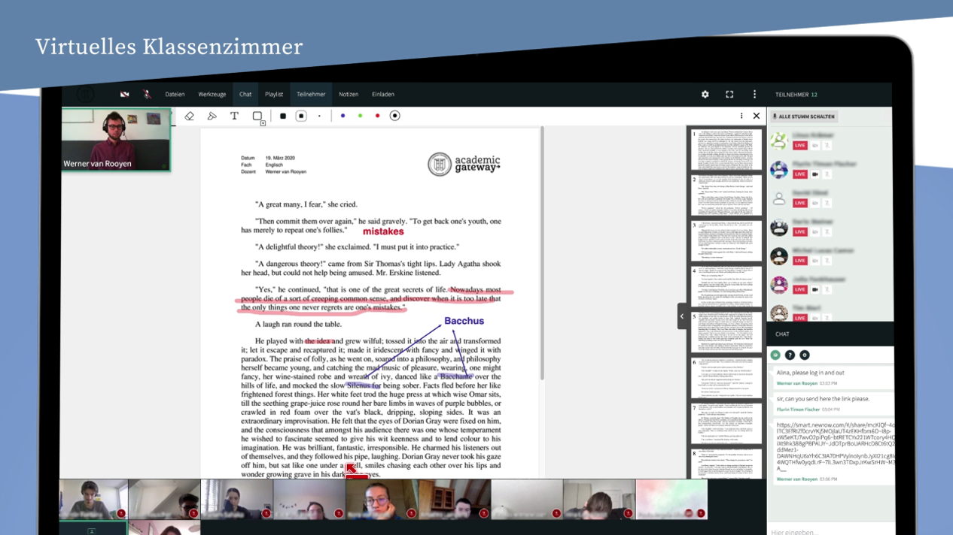
The Digital School
Virtual Classroom
E-Learning Insight
Notes:
Nach hinten packen

